Slide 1
Loan Default Prediction Project Presentation
Employing Data Analysis, Machine Learning & Neural Networks
Presented by: Sharel Cooper

Slide 2
Table of Contents
Motivation
Analysis
Machine Learning
Conclusions

Slide 3

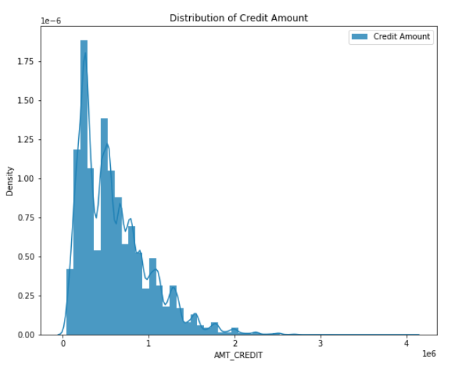
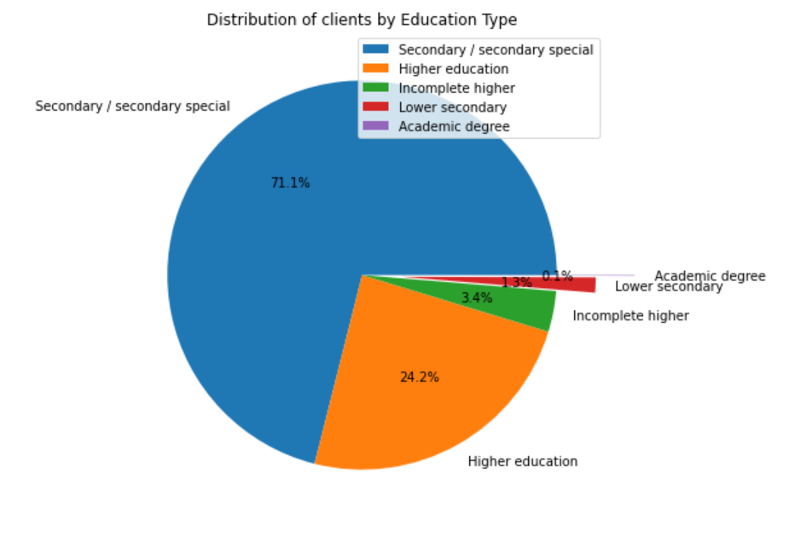
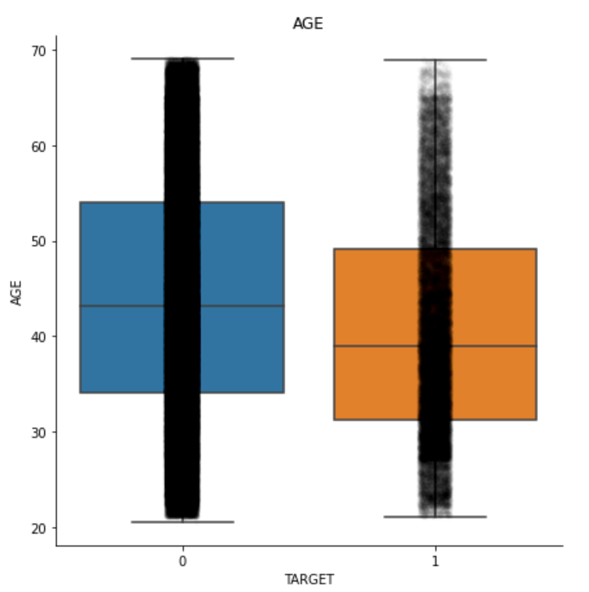
Motivation
Loan defaults are a significant risk to the revenue and solvency of the entire banking sector.
To explore and analyze what factors influence clients’ default
Build a Machine Learning Model to reduce risk for banks by attempting to predict clients with a higher probability of defaulting on a loan.
Analyze to determine what are important factors in the application process that can determine higher likelihoods for clients to default.

Slide 4
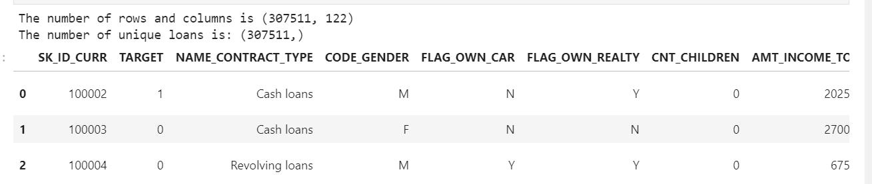
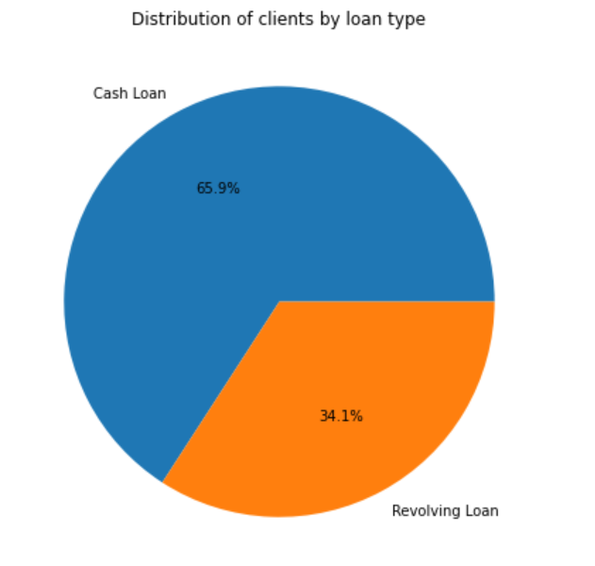
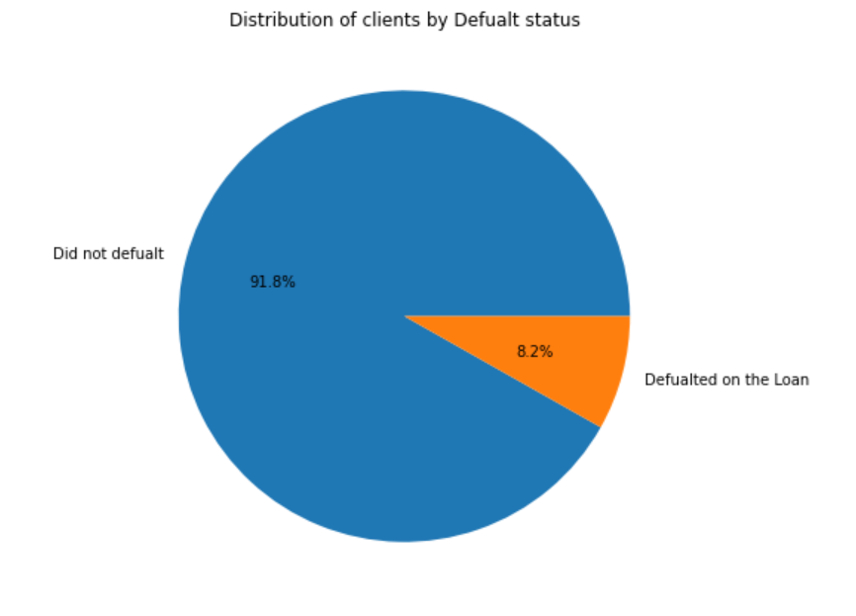
The Dataset: Contents
Our dataset contains over 370,000 unique lenders, their features, and whether they defaulted on the loan or not.
Over 120 features including income, credit amount, asset ownership, employment, and other categorical, discrete and continuous features.

Slide 5
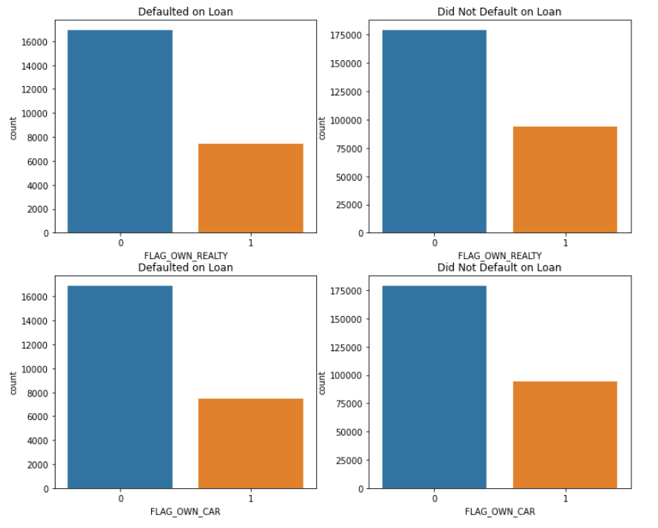
Analysis
Features used: Bar charts, scatter plots, histograms, box plots, pie charts, etc.
Ethical considerations must be made before using any of the following insights:
Analyze | Facts
Income of Client | ~Lower income on average results in increased probability for loan default
Age of client | ~Younger clients are more likely to default on the loan
Employment Period of Client | ~Clients with a longer employment period are less likely to default on the loan.
Education level | ~Secondary education level was overrepresented in the Default category. Higher education was underrepresented.
Occupation Type | Laborers are over represented in the Loan Default category.
Gender | Males are overrepresented in the Loan Default category.
Asset ownership (real estate, vehicle) | Those with assets are less likely to default on the loan.

Slide 6
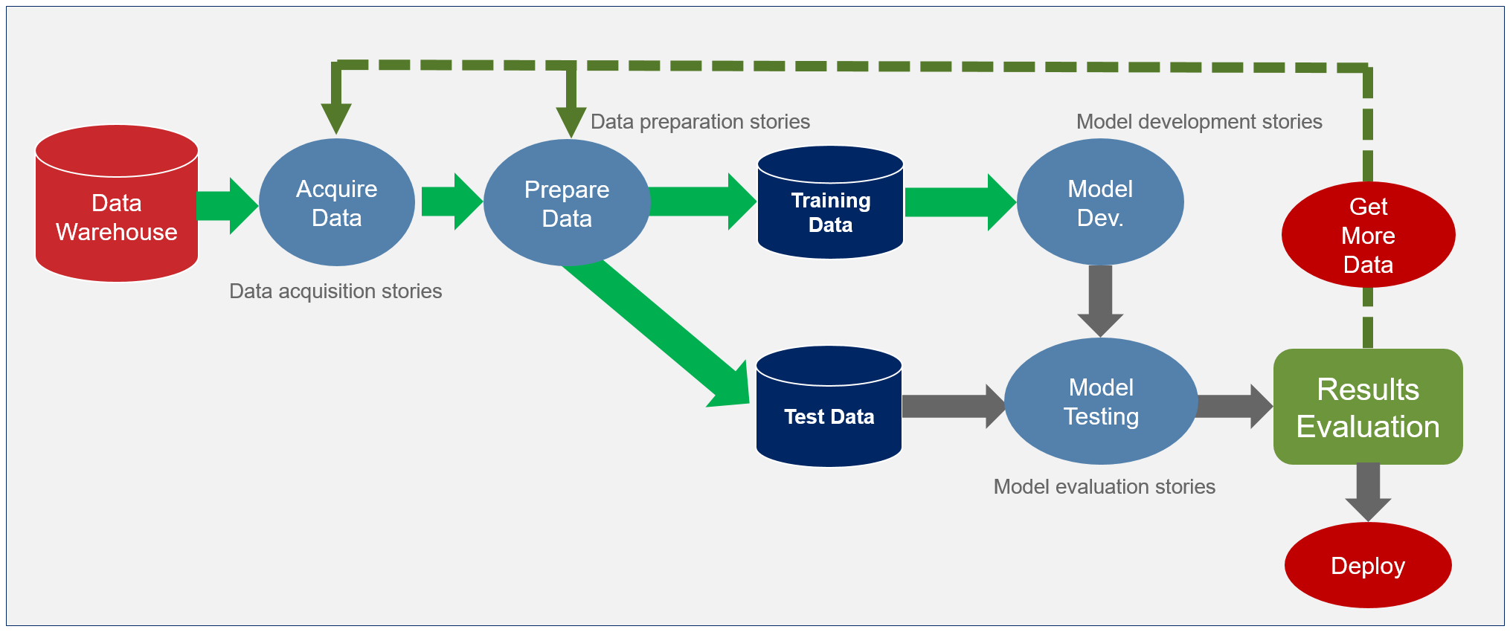




The Pipeline: Model Overview
SQL | Data Cleaning | Feature Engineering | EDA | ML Modelling | Deployment

Slide 7

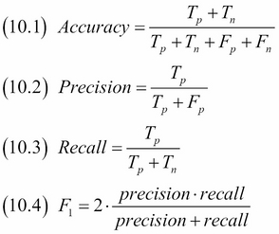
Machine Learning Results
Supervised Learning Algorithms:
Classifier | Accuracy | CV Accuracy | Precision | Recall | F1 Score
Decision Tree | 0.822958 | 0.842426 | 0.109595 | 0.163043 | 0.13108
RandomForest | 0.913562 | 0.918148 | 0.203947 | 0.019073 | 0.034884
Naive Bayes | 0.233766 | 0.087966 | 0.089014 | 0.90484 | 0.162084
KNeighbours | 0.670071 | 0.912285 | 0.100011 | 0.378589 | 0.158224
Logistic Regression | 0.626382 | 0.918097 | 0.128323 | 0.614848 | 0.21233
AdaBoostClassifier | 0.816827 | 0.918097 | 0.1416 | 0.244258 | 0.179273
Gradient Boosting Classifier | 0.915326 | 0.917996 | 0.225914 | 0.013946 | 0.02627
XGBoost | 0.917509 | 0.916989 | 0.330097 | 0.006973 | 0.013657
Recall is the most important metric for our purposes
Deep Learning Neural Network:
Classifier | Accuracy | Recall | Precision | F1 Score
ANN | 0.8334 | 0.2235 | 0.1509 | 0.1801

Slide 8

Conclusions
Actions based on Power BI analysis (organizational):
Reduce price of or optimize phone service quality
Reduce price of fiber optic internet or optimize internet service quality
Develop an incentive for annual contracts or run promotions for new customers with month-to-month contracts
Design loyalty programs to retain older customers
Better packaging of services to allow customers to see value of the broad range of services
Actions based on Machine Learning predictions (customer):
Once a customer is predicted to churn, understand why the customer might churn to determine optimal changes to current service offering or promotional deals to retain customer

Slide 9

Questions?
If you would like to access the code presented, or any of my other work, you may find it on GitHub: https://github.com/Bilalmajeed1995

